Slide 1
Owner Occupied Housing in the Irish CPI
UN Sprint on OOH, 20 September 2022
Edel Flannery, Central Statistics Office

Slide 2
Owner Occupied Housing (OOH)
Home ownership is 68% of households in Ireland - higher than France and Germany but lower than many other EA countries
No perfect method to measure OOH
Goal is to find the best (or the least worst) option in the context of the conceptual basis and measurement objectives of national CPI

Slide 3
Method used in national CPI in Ireland
Payments method since 1975 – has broad user acceptance, not at all controversial nationally
It measures what it was designed to measure i.e. changing costs faced by homeowners in relation to their mortgage interest payments, house insurance and maintenance and repair of the dwelling.
However conceptual problems e.g. borrowing costs are not consumption, incoherent measure across the target population
Plan is to replace the payments method – extensive user consultation will be required

Slide 4
OOHPI following net acquisitions approach
Compiled as per Regulation using administrative data (Stamp Duty returns from the Revenue Commissioners)
Sent to Eurostat quarterly
Stamp Duty returns in Ireland can be lodged up to 3 months after the purchase of a dwelling, so the OOHPI data is subject to revision
No National publication of OOHPI data

Slide 5
CSO commissioned research on OOH
“Rental equivalence, owner-occupied housing, and inflation measurement: Microlevel evidence from Ireland” - Journal Article in Real Estate Economics: External link: https://onlinelibrary.wiley.com/doi/10.1111/1540-6229.12360
“Estimating the cost of Irish housing for the CPI: A rental equivalence approach”, ESRI Working Paper: https://www.esri.ie/publications/estimating-the-cost-of-irish-housing-for-the-cpi-a-rental-equivalence-approach
“A review of the methodologies used in compiling owner-occupiers’ housing indices”, ESRI Working Paper: https://www.esri.ie/publications/a-review-of-the-methodologies-used-in-compiling-owner-occupiers-housing-indices

Slide 6
Summary of most recent paper
Rental Equivalence (RE) measure is theoretically suited to the consumption focus of CPI measurement i.e. not based on asset values – also meets frequency and timeliness criteria of CPI
Paper estimates a RE measure for OOH for Ireland using supervisory property-level rental data – calculates 32 separate regional hedonic rent models and uses the results to weight up to the RE index
Addresses three issues of concern:
differentiates between new (marginal) and existing (stock) rent levels – paper argues in favour of new rents while existing rents are commonly used in NSIs
controls for utility costs to calculate “pure” rent (similar to US CPI)
able to estimate an RE measure in the absence of rent controls

Slide 7
Some findings
RE index is very different from the official (payments approach) OOH index
RE index, adjusted for property types of OOH, is very different to an unadjusted rent index
Choice around using existing (stock), or new (marginal) rents matters a lot

Slide 8
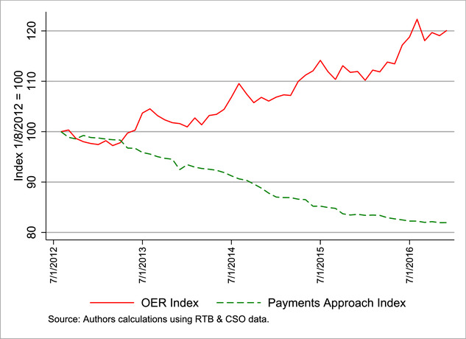
Rental equivalence v payments approach
Payments approach indicates a fall in the cost of OOH, whereas the RE measure is indicating a rise

Slide 9
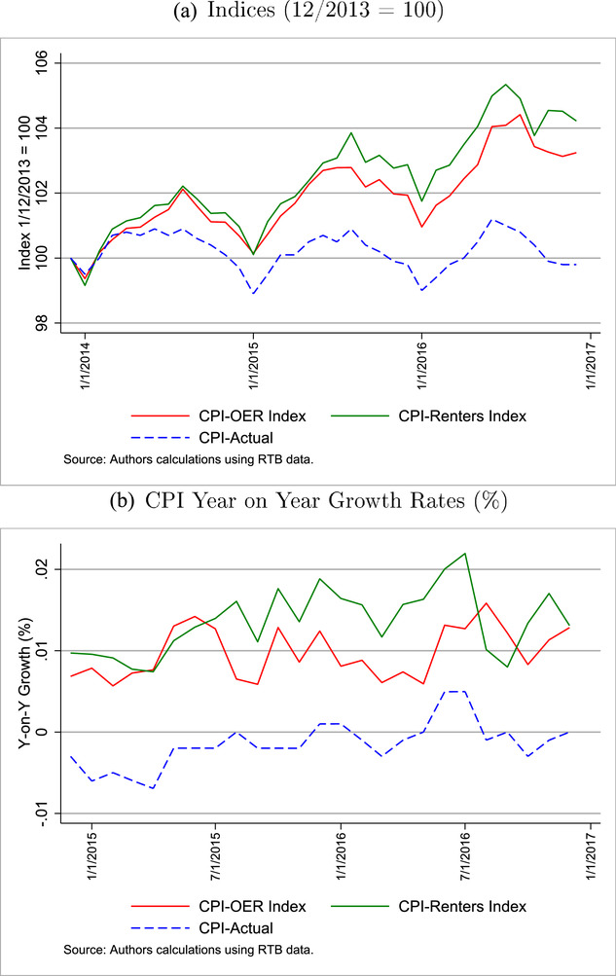
CPI actual v CPI+OOH (rental equivalence)
CPI actual = CPI+OOH following the payments approach
Significant difference between the CPI actual and CPI+OOH following rental equivalence
Weight of OOH goes from 5.6% (payments) to 16.3% (rental equivalence)
Notes:
The comparison CPI-renters index and CPI-OER index is important here. The renters index was calculated as a single hedonic index controlling for location and utilities – among other things. The OER index was calculated as a series of 32 hedonic indices, weighted together to reflect the structure of the OOH market.

Slide 10
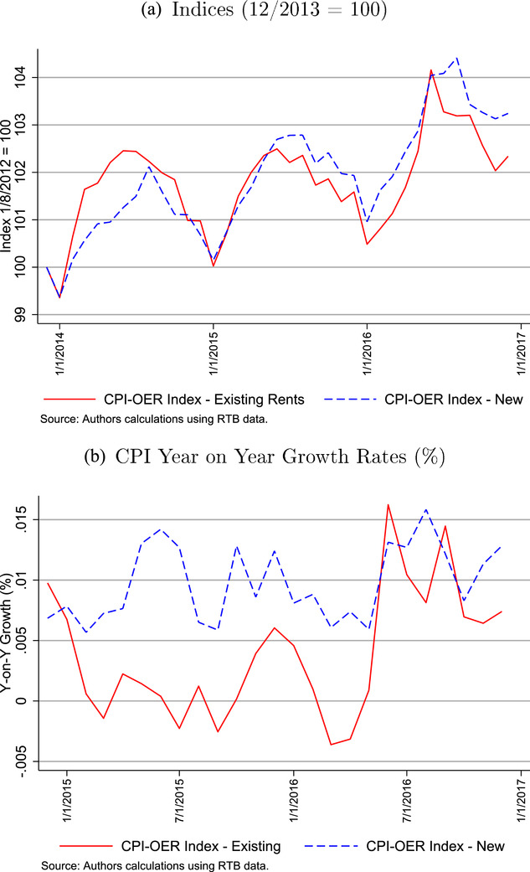
New (marginal) v existing (stock) rents
International literature is not clear on this point
The CPI is lower using existing (stock) rents
The annualized change in inflation was 0.6 percentage points lower using existing rents relative to new rents.

Slide 11
Where are we now?
HICP and Irish CPI have been converging for years – last major difference is OOH
We have a data source and a method and we are about to begin the user consultation to present the pros and cons - RE is currently the most likely candidate
The debate at European level is significantly complicating the national discussion
No desire for CPI+RE and HICP+NA – very difficult to explain to users

Slide 12

Thank you.
Questions?

